Slide 1
Optimization with TracePro : Examples
Property Optimization Example

Slide 2
COPYRIGHT NOTICE
These course notes are Copyright © 2020 by Lambda Research Corporation.
All rights reserved.
These course notes contain proprietary information. This information as well as the rest of the document may not be copied in whole or in part, or reproduced by any means, or transmitted in any form without the prior written consent of Lambda Research Corporation.

Slide 3
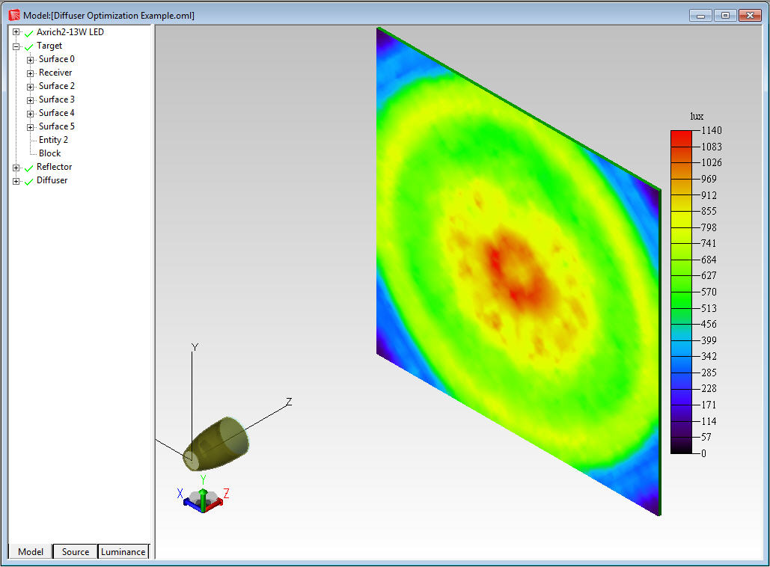
Property Optimization Example
The goal is to select the best Surface Property from a catalog of surface textures to produce the best uniformity on a target

Slide 4
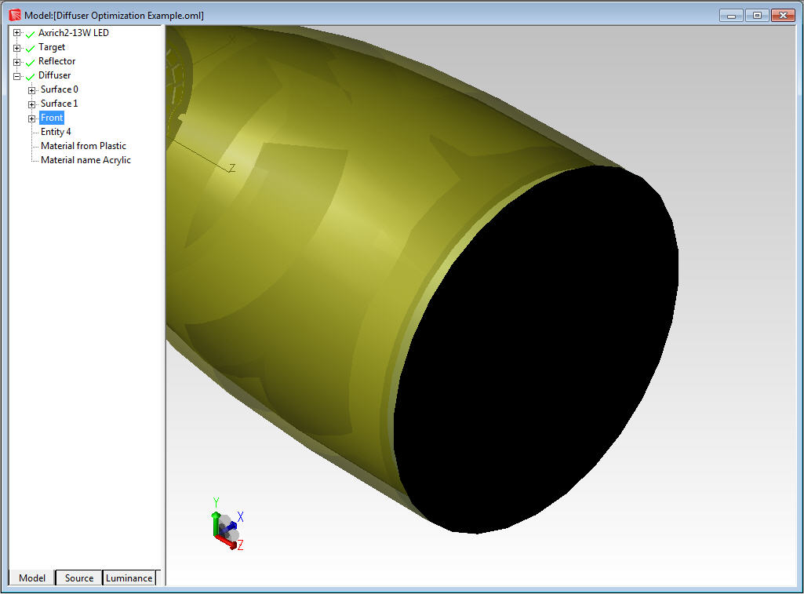
Property Optimization Example
The surface texture will be applied to the front surface of the diffuser. This surface is named “Front” in the TracePro model.

Slide 5
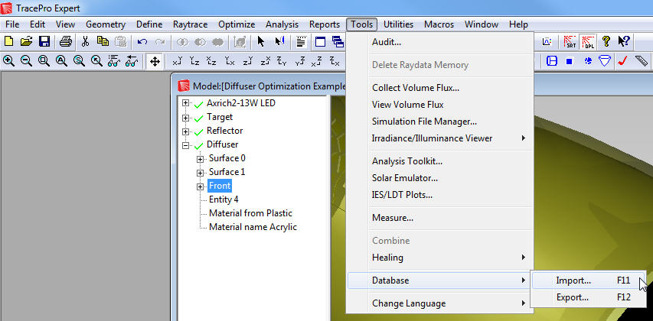
Property Optimization Example
Add the Seoul Semiconductor Acrich2-13W Surface Source Property to the TracePro property database by going to Tools->Database->Import and browsing to the file named “Acrich2-13W.txt”. This will make a new Surface Source Property catalog named “Seoul Semiconductor” and place the property there.

Slide 6
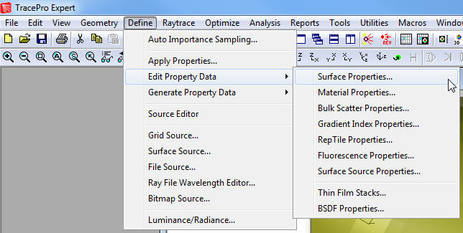
Property Optimization Example
Go to Define->Edit Property Data->Surface Properties.

Slide 7
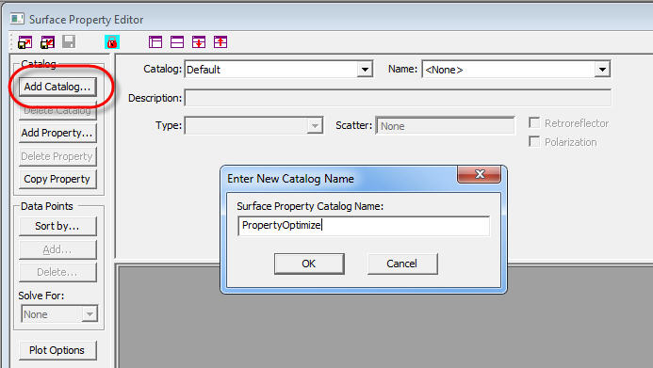
Property Optimization Example
In the Surface Property Editor window, click Add Catalog and add a new Catalog named PropertyOptimize.

Slide 8
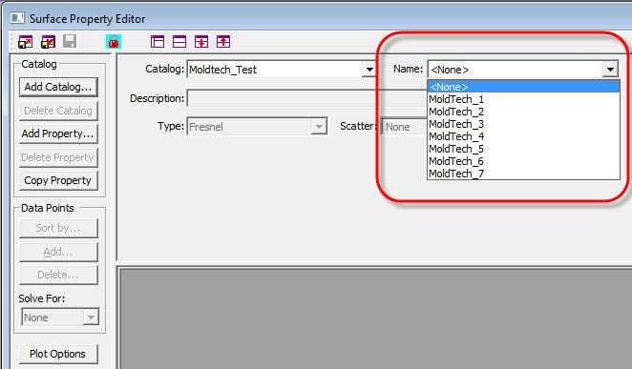
Property Optimization Example
In order to scan through the Surface Properties in a catalog using the 3D Interactive Optimizers, the properties need have the same name, varying by a number appended to the end of the file name. For example: Property_1, Property_2, Property_3, …..

Slide 9
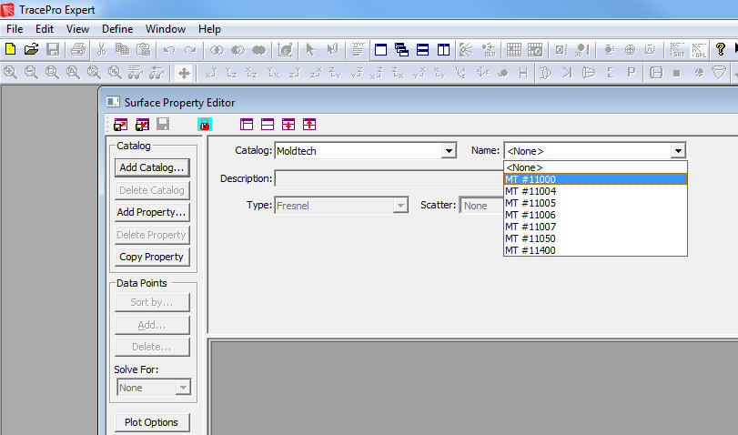
Property Optimization Example
This example will use the Surface Properties in the MoldTech catalog in TracePro. Open the Surface Property Editor window at Define->Edit Property Data->Surface Properties and select the Moldtech Catalog.

Slide 10
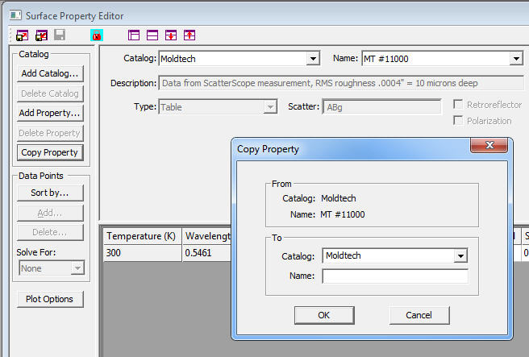
Property Optimization Example
Select the first property in the Moldtech catalog, “MT, #11000”, and then click Copy Property.

Slide 11
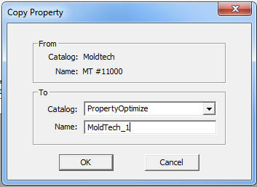
Property Optimization Example
In the Copy Property dialog box, change the Catalog to PropertyOptimize and give the property the name “MoldTech_1”. Click OK to save the new property.

Slide 12
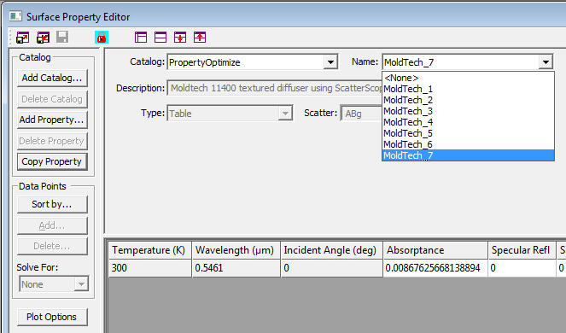
Property Optimization Example
Repeat this process for the remaining 6 surface properties in the Moldtech catalog.

Slide 13
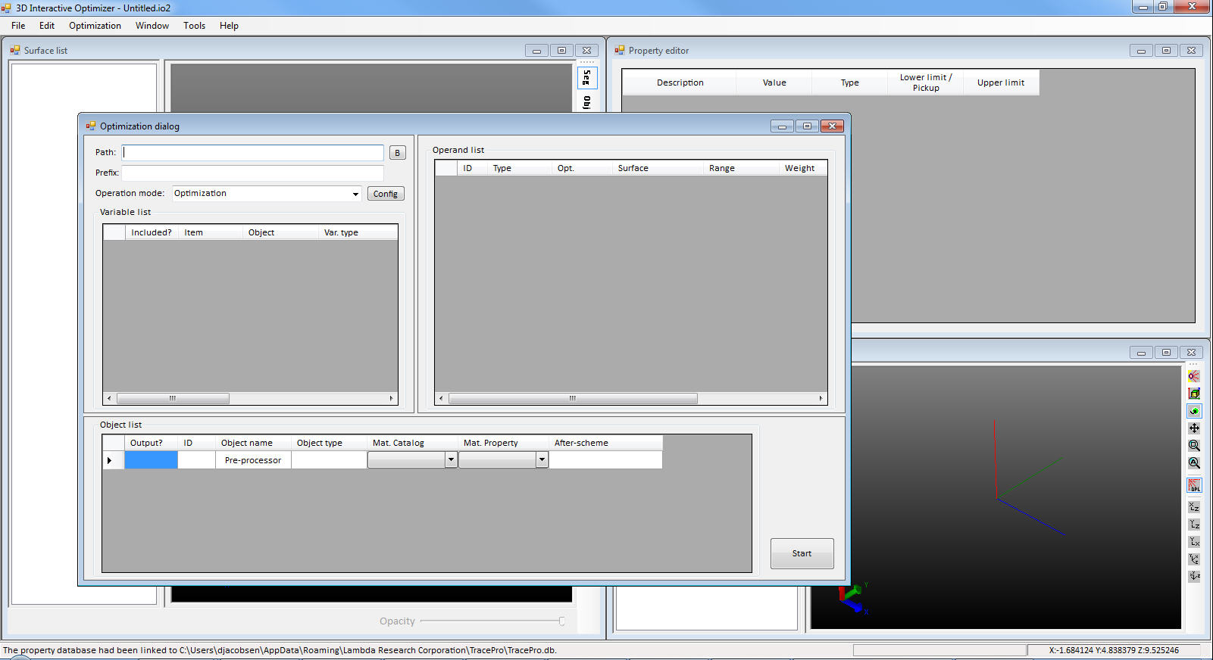
Property Optimization Example
Open the 3D Interactive Optimizer and then open the Optimization Dialog window by clicking Optimization in the top menu bar.

Slide 14
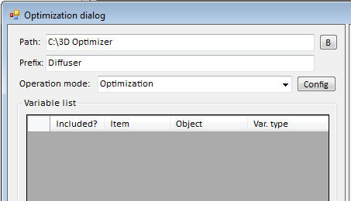
Property Optimization Example
Define a Path: and Prefix:

Slide 15
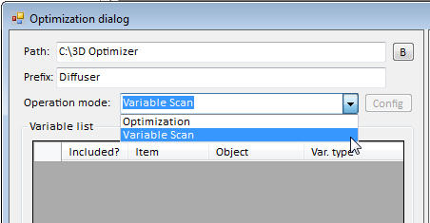
Property Optimization Example
Change the Operation Mode: to Variable Scan

Slide 16
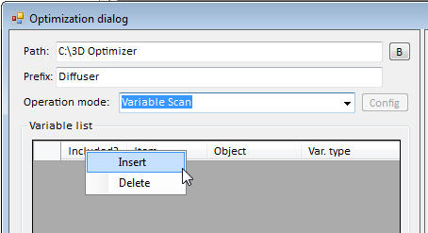
Property Optimization Example
Right Click in the Variable List portion of the window and choose Insert to insert a User-Defined variable

Slide 17
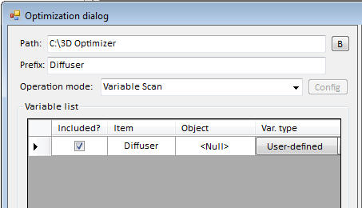
Property Optimization Example
Apply the name “Diffuser” to the User-Defined variable in the “Item” cell.

Slide 18
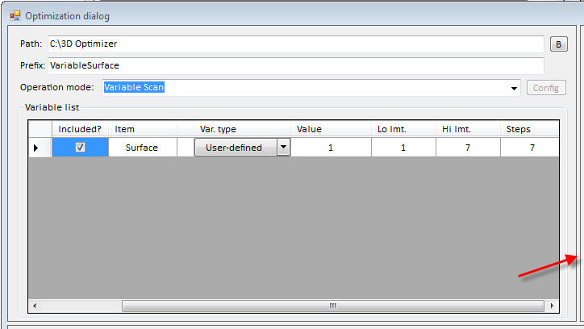
Property Optimization Example
Note that the dividing bar between portions of the window can be moved to show more or less of that portion of the dialog box.

Slide 19
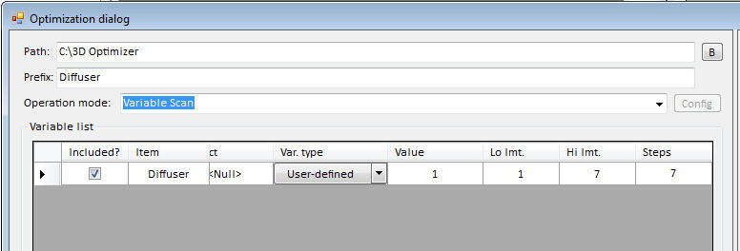
Property Optimization Example
Enter the following values for the User-Defined variable: Value = 1, Lo lmt. = 1, Hi lmt. = 7, Steps = 7. This will give the variable an initial value of 1 with a lower limit of 1, an upper limit of 7, and 7 steps between the low and high limits.

Slide 20
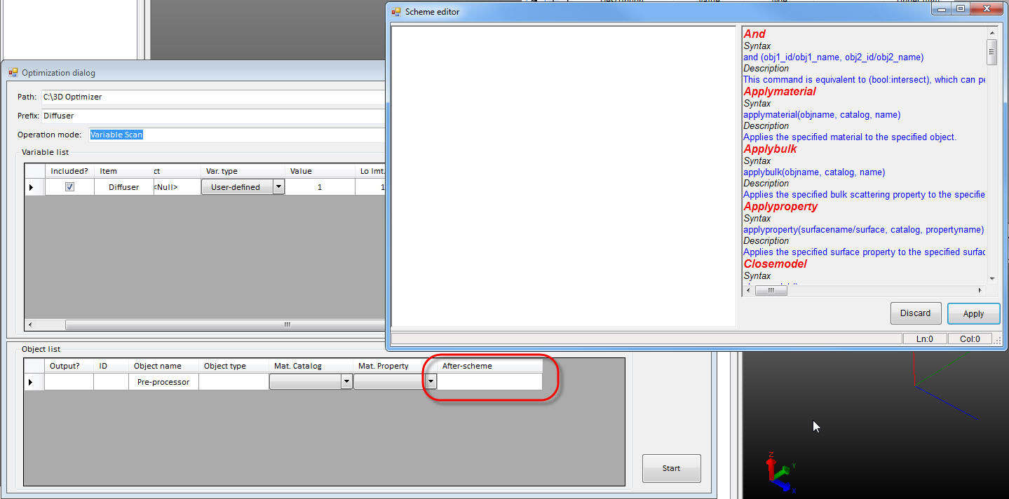
Property Optimization Example
Double click in the After-scheme cell for the Pre-processor line in the Object List to open the Scheme Editor window

Slide 21
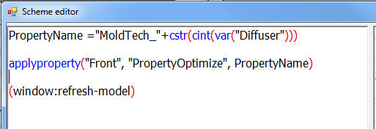
Property Optimization Example
Enter the After Scheme macros commands shown below in the Scheme Editor window

Slide 22
Property Optimization Example
The first line in the After Scheme macro defines a variable named “PropertyName” and assigns the value “MoldTech_”+cstr(cint(var(“Diffuser”))) to the variable
The cstr command converts a character to a string
The cint command assures that the value is an integer
The var command is the User-Defined variable

Slide 23
Property Optimization Example
The first pass through the optimization process the variable PropertyName will have the value “MoldTech_1”. In the second iteration it will be “MoldTech_2”, and so on until the last value is reached.

Slide 24
Property Optimization Example
The second line applies the Surface Property to the surface named “Front” in the TracePro model. In this example the name of the surface property is defined by PropertyName, the catalog is “PropertyOptimize”, and the surface the property is applied to is “Front”.

Slide 25
Property Optimization Example
The last line refreshes the model window in TracePro.

Slide 26
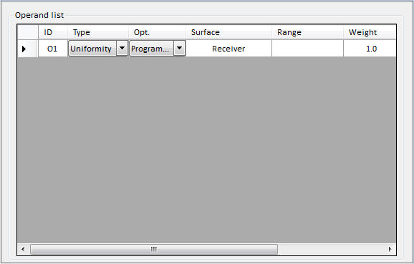
Property Optimization Example
Add a Uniformity operand in the Operand List window. Enter “Receiver” for the Surface name.

Slide 27
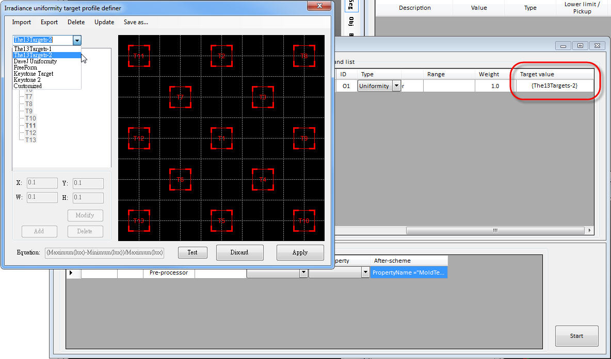
Property Optimization Example
Double click in the Target Value cell and then choose “The 13 Targets-2” from the dropdown menu and click Apply.

Slide 28
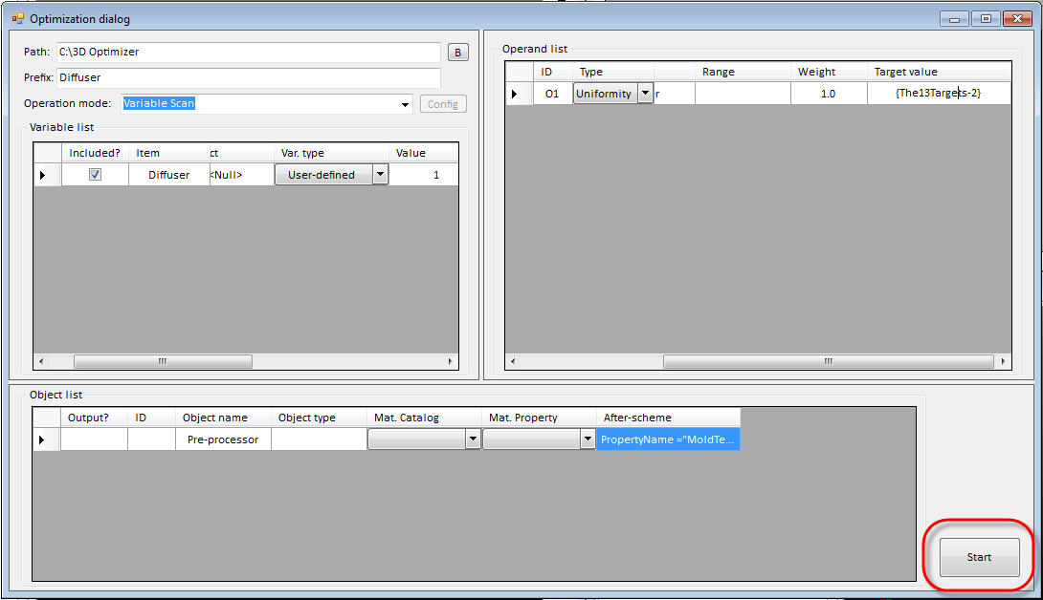
Property Optimization Example
Click Start to start the optimization process.

Slide 29
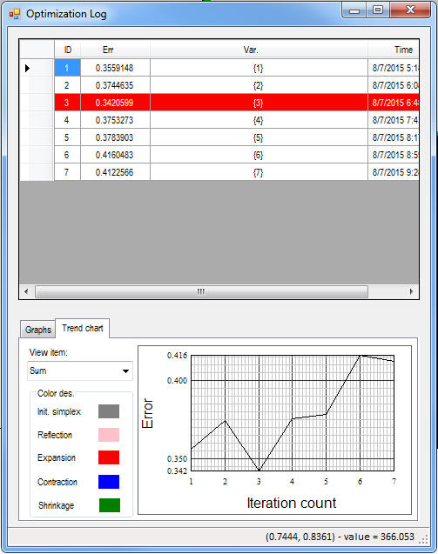
Property Optimization Example
Optimization Log

Slide 30
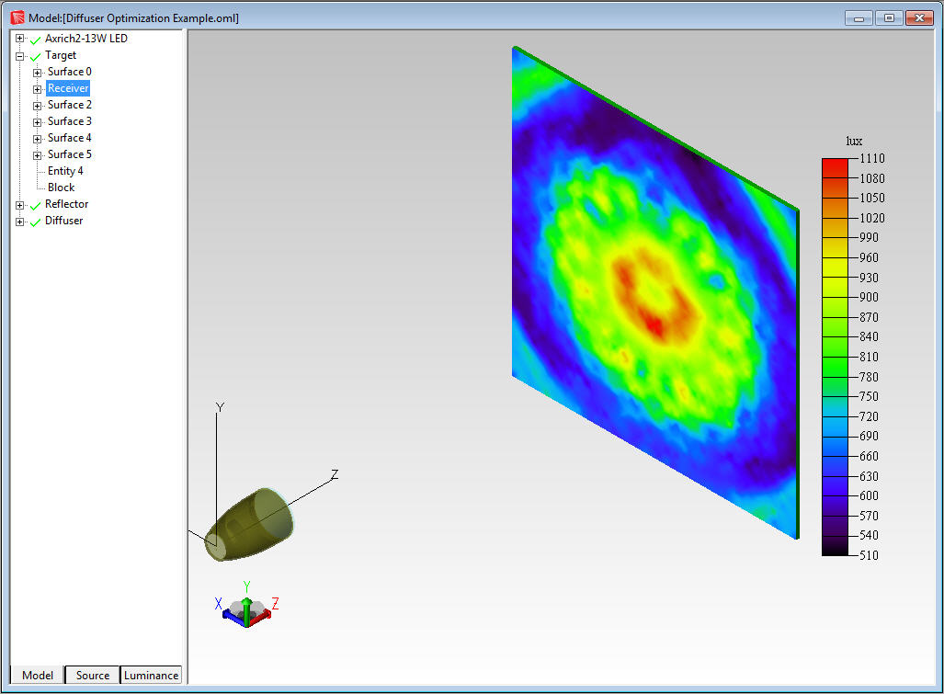
Property Optimization Example
Irradiance Map for optimized solution

