Slide 1

Optics software for layout and optimization
Powerful optical design and engineering at your fingertips
Lambda Research Corporation

Slide 2
Optical design and engineering
Forming Images
2

Slide 3
Optical design and engineering
Forming Images
Accurately Separate Wavelengths
2

Slide 4
Optical design and engineering
Forming Images
Condensing Systems
Accurately Separating Wavelengths
2

Slide 5
Optical design and engineering
Used on COSTAR Program to Correct the Hubble Space Telescope
3

Slide 6
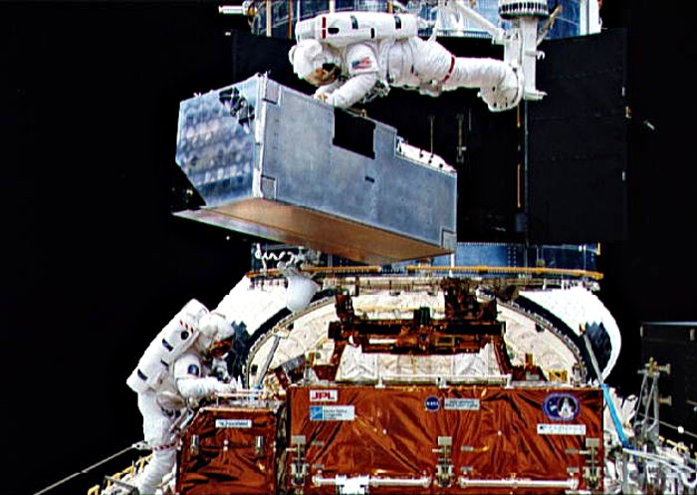
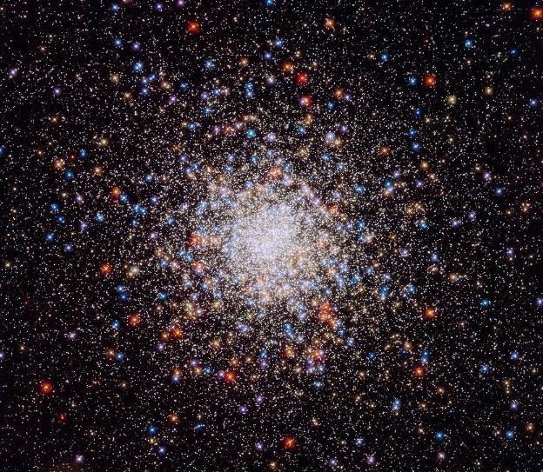
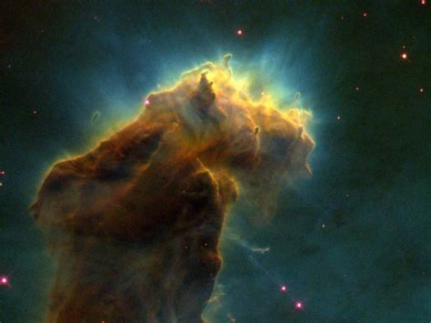
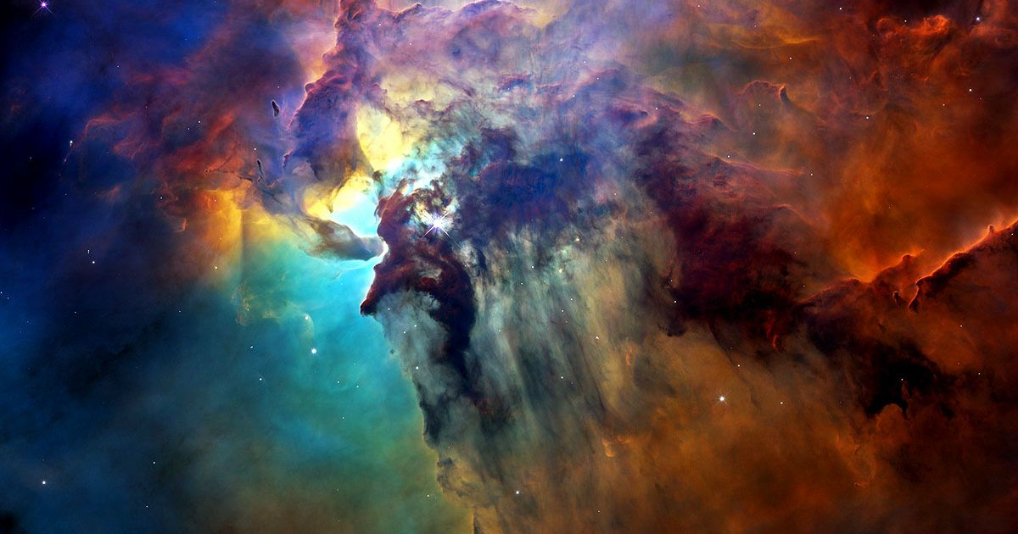
Optical design and engineering
Used on COSTAR Program to Correct the Hubble Space Telescope
Images from NASA/ESA
4

Slide 7
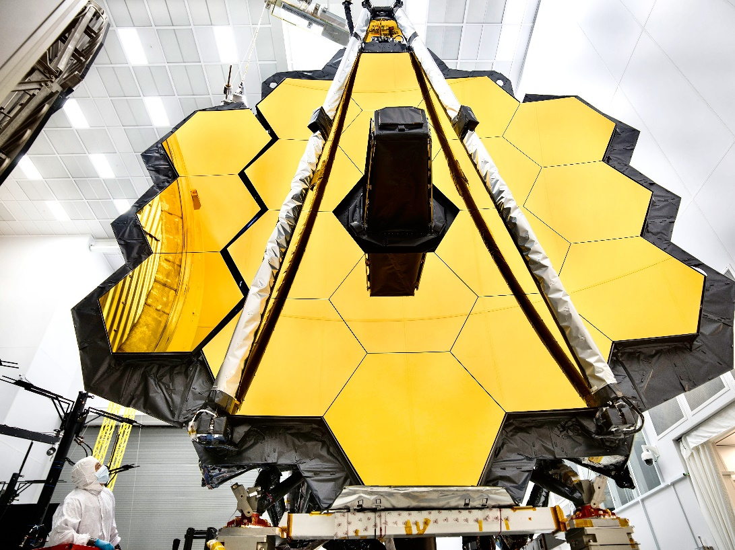
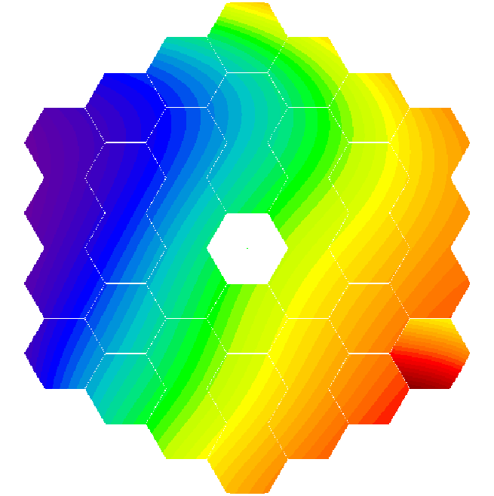
Optical design and engineering
Engineering the James Webb Space Telescope
Segmented hexagonal mirror modeling in OSLO
Image from NASA
5

Slide 8
Optical design and engineering
Zoom systems and multiconfiguration
Up to 300:1 achieved using OSLO
6

Slide 9
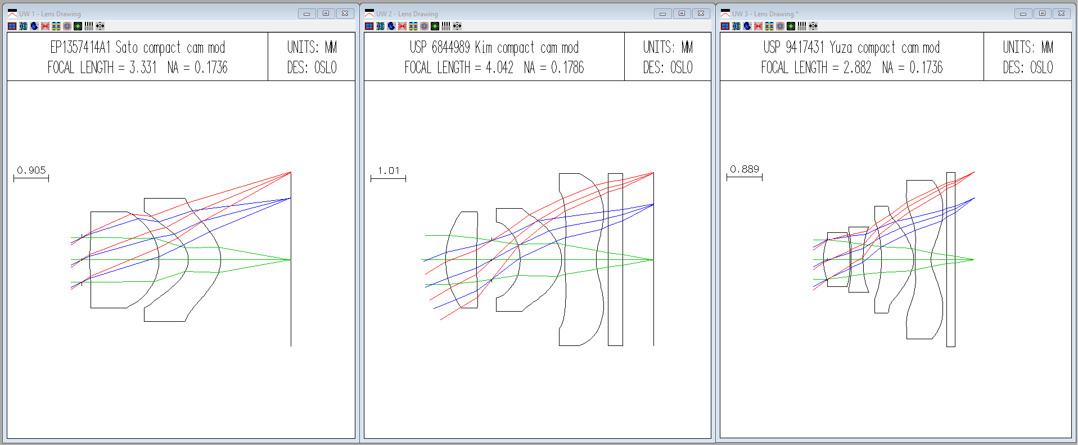
Optical design and engineering
Camera systems including compact camera lenses
7

Slide 10
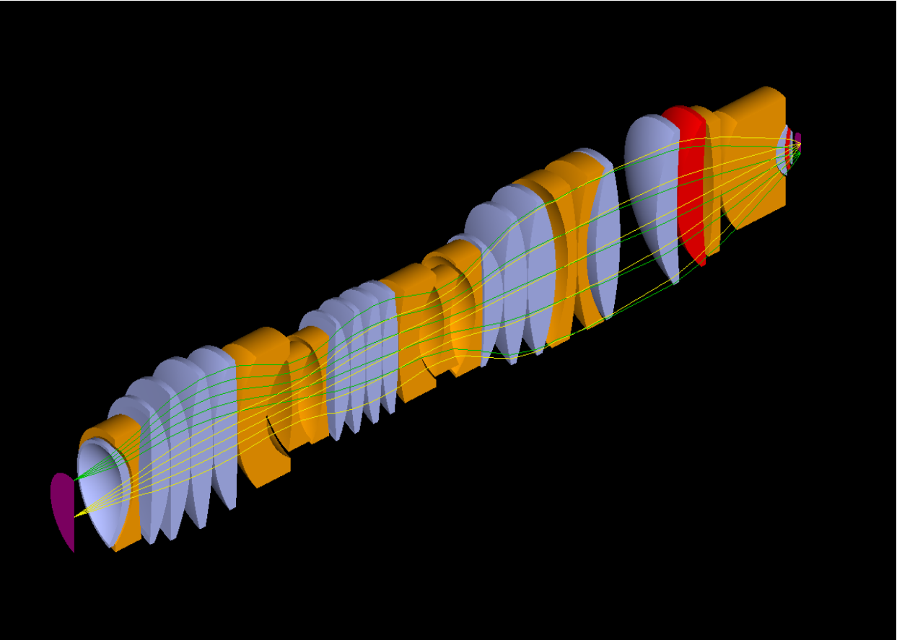
Optical design and engineering
Challenging lenses for use in photolithography and microscopy
8

Slide 11
Optical design and engineering
Challenging lenses for use in photolithography and microscopy
8

Slide 12
Optical design and engineering
Laser systems
9

Slide 13
Optical design and engineering
Laser systems
9

Slide 14
Optical design and engineering
Success with numerous additional applications and systems
10

Slide 15
Optical design and engineering
Success with numerous additional applications and systems
10

Slide 16

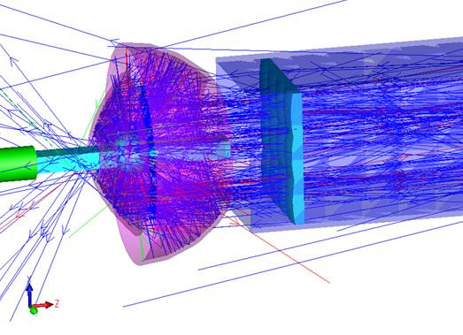
Optical design and engineering
Designed to work in tandem with
Non-sequential ray-trace for a projector
10

